Slide 1
Data Preprocessing
Based on “Introduction to Data Mining” by
Tan, Steinbach, Karpatne, Kumar

Slide 2
Outline
Features and Instances
Types of Data
Data Quality
Similarity and Distance
Data Preprocessing

Slide 3
What is Data?
Collection of data instances and their features
An feature is a property or characteristic of an instance
Examples: eye color of a person, temperature, etc.
feature is also known as variable, field, characteristic, dimension, or attribute
A collection of features describe an instance
Instance is also known as object, record, data point, sample or entity
features
Instances

Slide 4
Types of features
There are different types of features
Nominal
Examples: ID numbers, eye color, zip codes
Ordinal
Examples: rankings (e.g., taste of potato chips on a scale from 1-10), grades, height {tall, medium, short}
Interval
Examples: calendar dates, temperatures in Celsius or Fahrenheit.
Ratio
Examples: temperature in Kelvin, length, counts, elapsed time (e.g., time to run a race)

Slide 6
Discrete and Continuous features
Discrete feature
Has only a finite set of values
Examples: postal codes, counts, or the set of words in a collection of documents
Often represented as integer variables.
Note: binary features are a special case of discrete features
Continuous feature
Has real numbers as feature values
Examples: temperature, height, or weight.
Practically, real values can only be measured and represented using a finite number of digits.
Continuous features are typically represented as floating-point variables.

Slide 7
Key Messages for feature Types
The types of operations you choose should be “meaningful” for the type of data you have
Distinctness, order, meaningful intervals, and meaningful ratios are only four (among many possible) properties of data
The data type you see – often numbers or strings – may not capture all the properties or may suggest properties that are not present
Analysis may depend on these other properties of the data
Many statistical analyses depend only on the distribution
In the end, what is meaningful can be specific to domain

Slide 8
Important Characteristics of Data
Dimensionality (number of features)
High dimensional data brings a number of challenges
Sparsity
Only presence counts
Resolution
Patterns depend on the scale
Size
Type of analysis may depend on size of data

Slide 9
Types of data sets
Record
Data Matrix
Document Data
Transaction Data
Graph
World Wide Web
Molecular Structures
Ordered
Spatial Data
Temporal Data
Sequential Data
Genetic Sequence Data

Slide 10
Record Data
Data that consists of a collection of records, each of which consists of a fixed set of features

Slide 11
Graph Data
Examples: Generic graph, a molecule, and webpages
Benzene Molecule: C6H6

Slide 12
Ordered Data
Genomic sequence data

Slide 13
Ordered Data
Spatio-Temporal Data
Average Monthly Temperature of land and ocean

Slide 14
Data Quality
Poor data quality negatively affects many data processing efforts
Data mining example: a classification model for detecting people who are loan risks is built using poor data
Some credit-worthy candidates are denied loans
More loans are given to individuals that default

Slide 15
Data Quality …
What kinds of data quality problems?
How can we detect problems with the data?
What can we do about these problems?
Examples of data quality problems:
Noise and outliers
Wrong data
Fake data
Missing values
Duplicate data

Slide 16
Noise
For instances, noise is an extraneous instance
For features, noise refers to modification of original values
Examples: distortion of a person’s voice when talking on a poor phone and “snow” on television screen
The figures below show two sine waves of the same magnitude and different frequencies, the waves combined, and the two sine waves with random noise
The magnitude and shape of the original signal is distorted

Slide 17
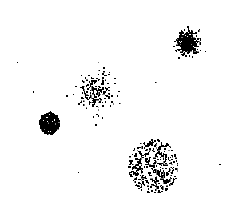
Outliers
Outliers are data instances with characteristics that are considerably different than most of the other data instances in the data set
Case 1: Outliers are noise that interferes with data analysis
Case 2: Outliers are the goal of our analysis
Credit card fraud
Intrusion detection

Slide 18
Missing Values
Reasons for missing values
Information is not collected (e.g., people decline to give their age and weight)
features may not be applicable to all cases (e.g., annual income is not applicable to children)
Handling missing values
Eliminate data instances or variables
Estimate missing values
Example: time series of temperature
Example: census results
Ignore the missing value during analysis

Slide 19
Duplicate Data
Data set may include data instances that are duplicates, or almost duplicates of one another
Major issue when merging data from heterogeneous sources
Examples:
Same person with multiple email addresses
Data cleaning
Process of dealing with duplicate data issues

Slide 20
Similarity and Dissimilarity Measures
Similarity measure
Numerical measure of how alike two data instances are.
Is higher when instances are more alike.
Often falls in the range [0,1]
Dissimilarity measure
Numerical measure of how different two data instances are
Lower when instances are more alike
Minimum dissimilarity is often 0
Upper limit varies
Proximity refers to a similarity or dissimilarity

Slide 21
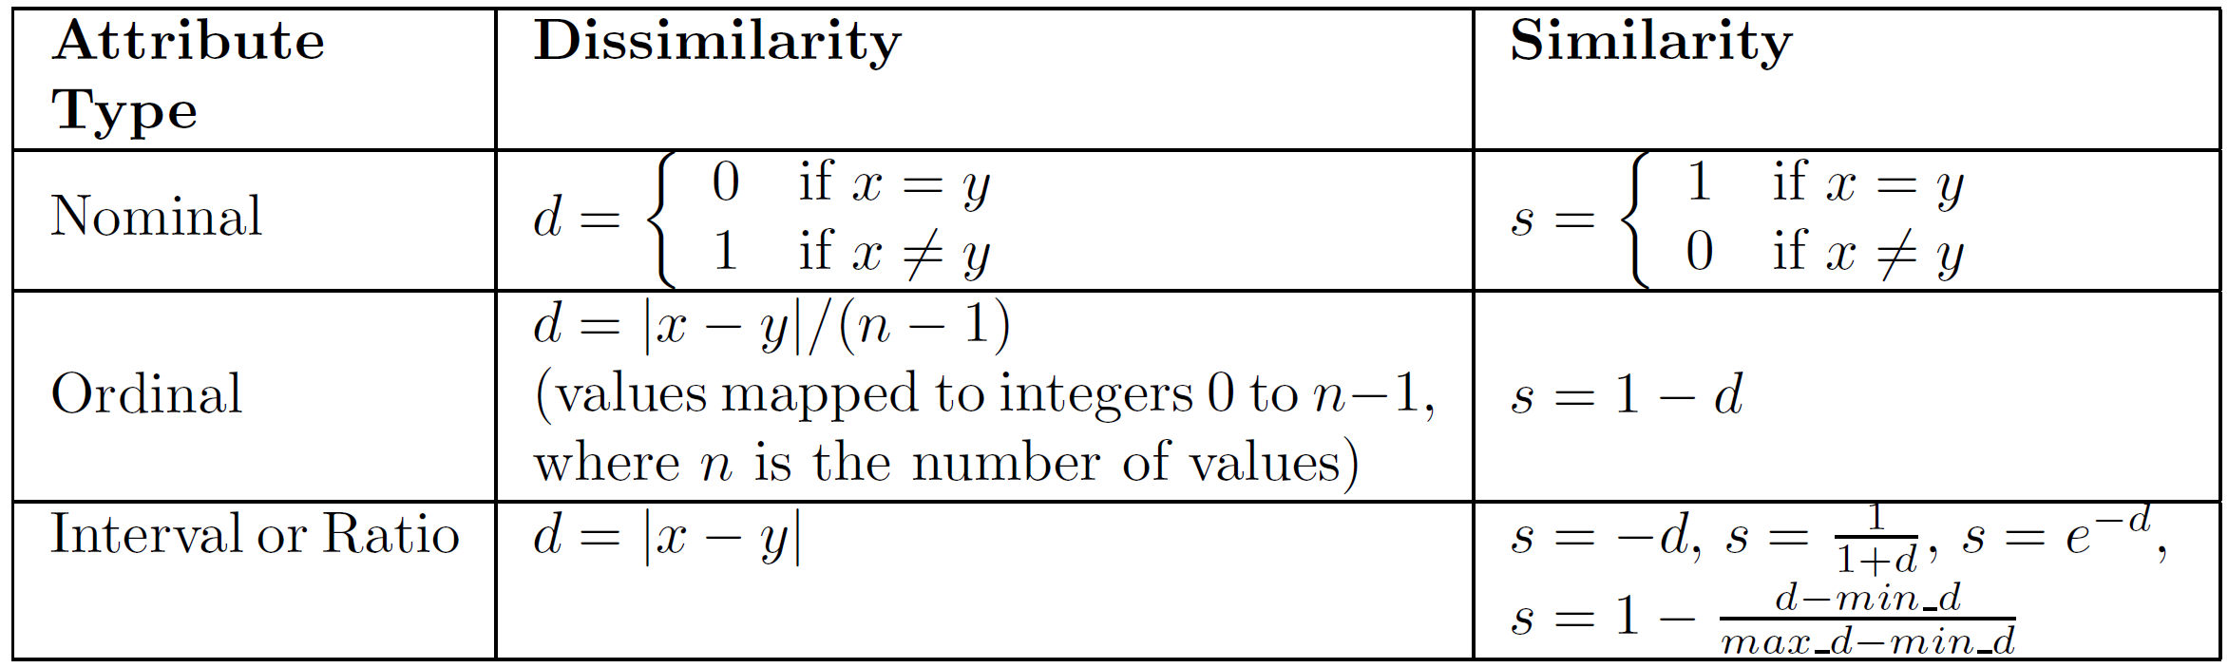
Similarity/Dissimilarity for Simple features
The following table shows the similarity and dissimilarity between two instances, x and y, with respect to a single, simple feature.

Slide 22
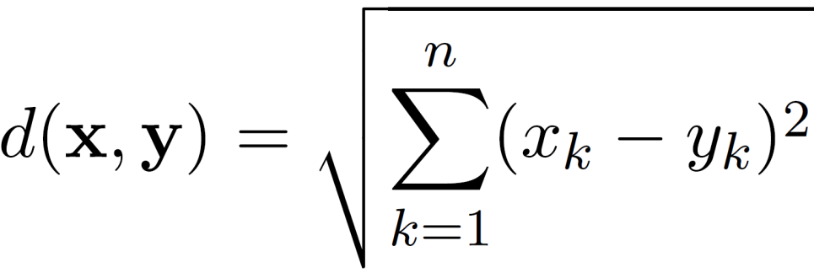
Euclidean Distance
Euclidean Distance
where n is the number of dimensions (features) and x_{k} and y_{k} are, respectively, the k^{th} features (components) or data instances x and y.
Standardization is necessary, if scales differ.
Other distances (Manhattan, Monkowski, Mahalanabis, etc.) are also used.

Slide 23
Euclidean Distance
Distance Matrix

Slide 24
Common Properties of a Distance
Distances, such as the Euclidean distance, have some well known properties.
d(x, y) ≥ 0 for all x and y and d(x, y) = 0 if and only if x = y.
d(x, y) = d(y, x) for all x and y. (Symmetry)
d(x, z) ≤ d(x, y) + d(y, z) for all points x, y, and z. (Triangle Inequality)
where d(x, y) is the distance (dissimilarity) between points (data instances), x and y.
A distance that satisfies these properties is a metric

Slide 25
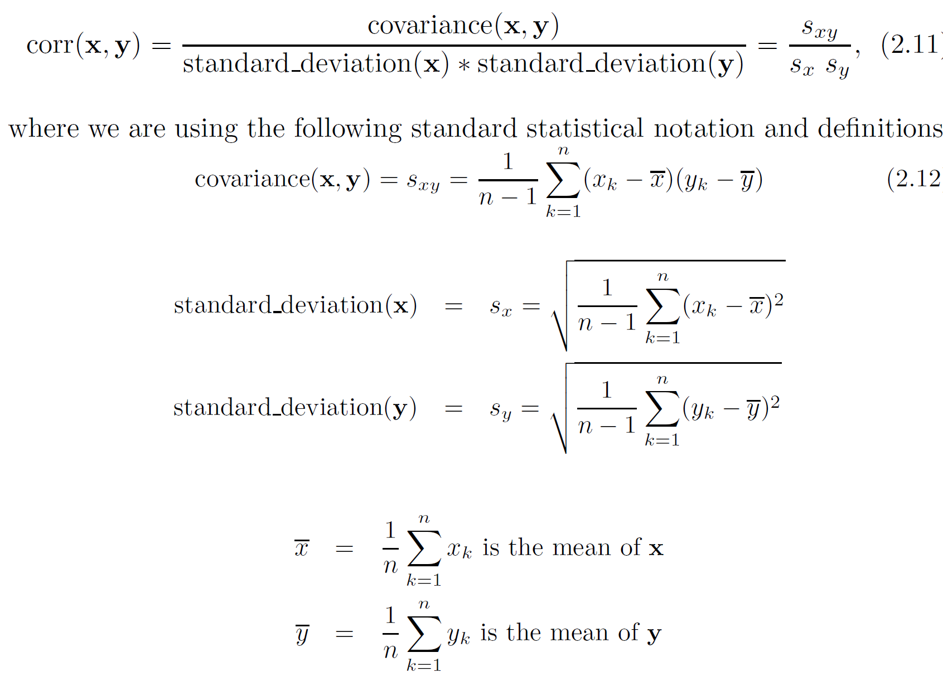
Correlation measures the linear relationship between instances

Slide 26
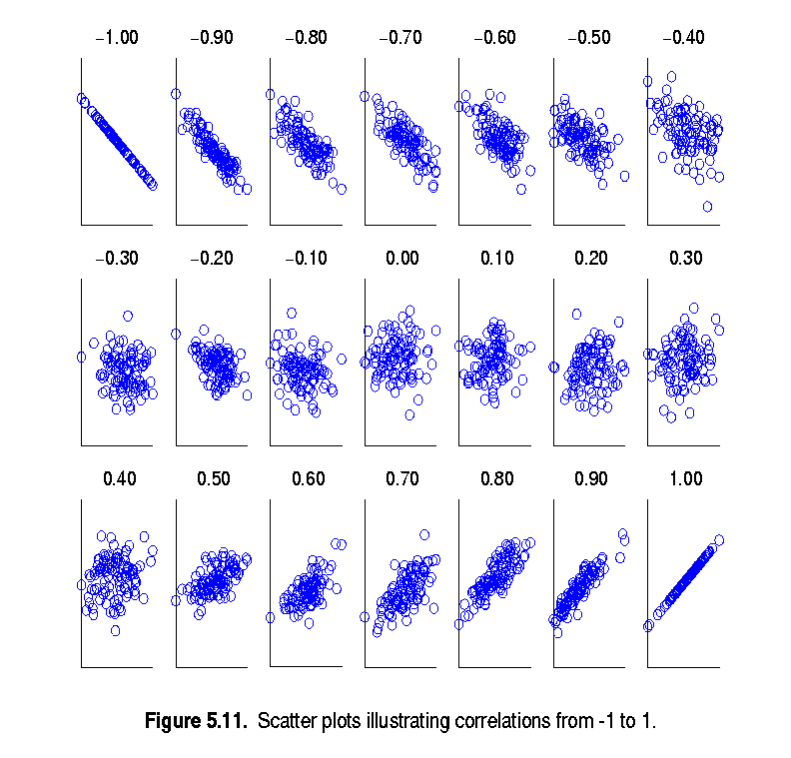
Visually Evaluating Correlation
Scatter plots showing the similarity from –1 to 1.

Slide 27
Data Preprocessing
Aggregation
Sampling
Discretization and Binarization
feature Transformation
Dimensionality Reduction
Feature subset selection
Feature creation

Slide 28
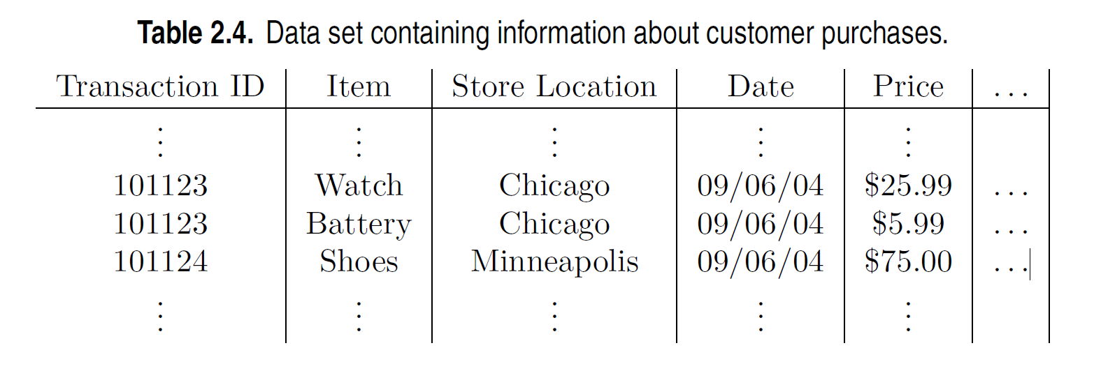
Aggregation
Combining two or more features (or instances) into a single feature (or instance)
Purpose
Data reduction - reduce the number of features or instances
Change of scale
Cities aggregated into regions, states, countries, etc.
Days aggregated into weeks, months, or years
More “stable” data - aggregated data tends to have less variability

Slide 29
Sampling
Sampling is the main technique employed for data reduction.
It is often used for both the preliminary investigation of the data and the final data analysis.
Statisticians often sample because obtaining the entire set of data of interest is too expensive or time consuming.
Using a sample will work almost as well as using the entire data set, if the sample is representative

Slide 30

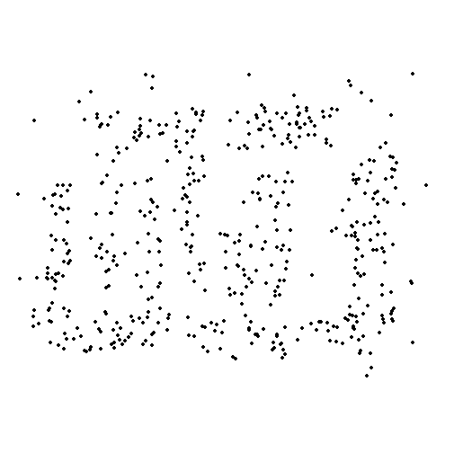
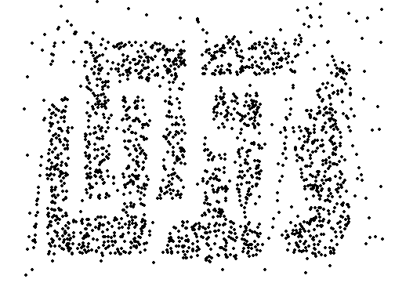
Sample Size
8000 points 2000 Points 500 Points

Slide 31
Types of Sampling
Simple Random Sampling
There is an equal probability of selecting any particular item
Sampling without replacement
As each item is selected, it is removed from the population
Sampling with replacement
instances are not removed from the population as they are selected for the sample.
In sampling with replacement, the same instance can be picked up more than once
Stratified sampling
Split the data into several partitions; then draw random samples from each partition

Slide 32
Discretization
Discretization is the process of converting a continuous feature into an ordinal feature
A potentially infinite number of values are mapped into a small number of categories
Discretization is used in both unsupervised and supervised settings

Slide 33
Binarization
Binarization maps a continuous or categorical feature into one or more binary variables

Slide 34
Feature Transformation
A feature transform is a function that maps the entire set of values of a given feature to a new set of replacement values such that each old value can be identified with one of the new values
Simple functions: x^{k}, log(x), e^{x}, |x|
Normalization
Refers to various techniques to adjust to differences among features in terms of frequency of occurrence, mean, variance, range
Take out unwanted, common signal, e.g., seasonality
In statistics, standardization refers to subtracting off the means and dividing by the standard deviation

Slide 35
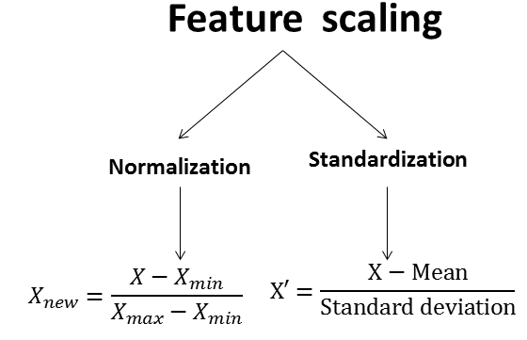
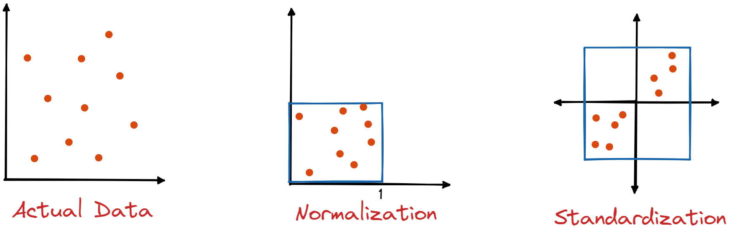
Feature Scaling

Slide 36
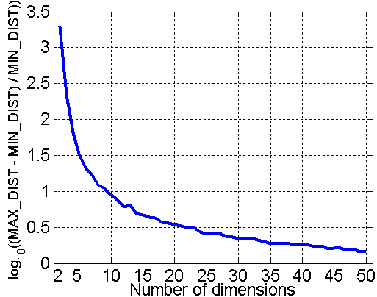
Curse of Dimensionality
When dimensionality increases, data becomes increasingly sparse in the space that it occupies
Definitions of density and distance between points, which are critical for clustering and outlier detection, become less meaningful
Randomly generate 500 points
Compute difference between max and min distance between any pair of points

Slide 37
Dimensionality Reduction
Purpose:
Avoid curse of dimensionality
Reduce amount of time and memory required by data mining algorithms
Allow data to be more easily visualized
May help to eliminate irrelevant features or reduce noise
Techniques
Principal Components Analysis (PCA)
Singular Value Decomposition
T-SNE
Others: supervised and non-linear techniques

Slide 38
Dimensionality Reduction: PCA
Goal is to find a projection that captures the largest amount of variation in data
x₂
e
x₁

Slide 39
Feature Subset Selection
Another way to reduce dimensionality of data
Redundant features
Duplicate much or all of the information contained in one or more other features
Example: purchase price of a product and the amount of sales tax paid
Irrelevant features
Contain no information that is useful for the data mining task at hand
Example: students' ID is often irrelevant to the task of predicting students' GPA
Many techniques developed, especially for classification

Slide 40
Feature Creation
Create new features that can capture the important information in a data set much more efficiently than the original features
Three general methodologies:
Feature extraction
Example: extracting edges from images
Feature construction
Example: dividing mass by volume to get density
Mapping data to new space
Example: Fourier and wavelet analysis

